Slide 1
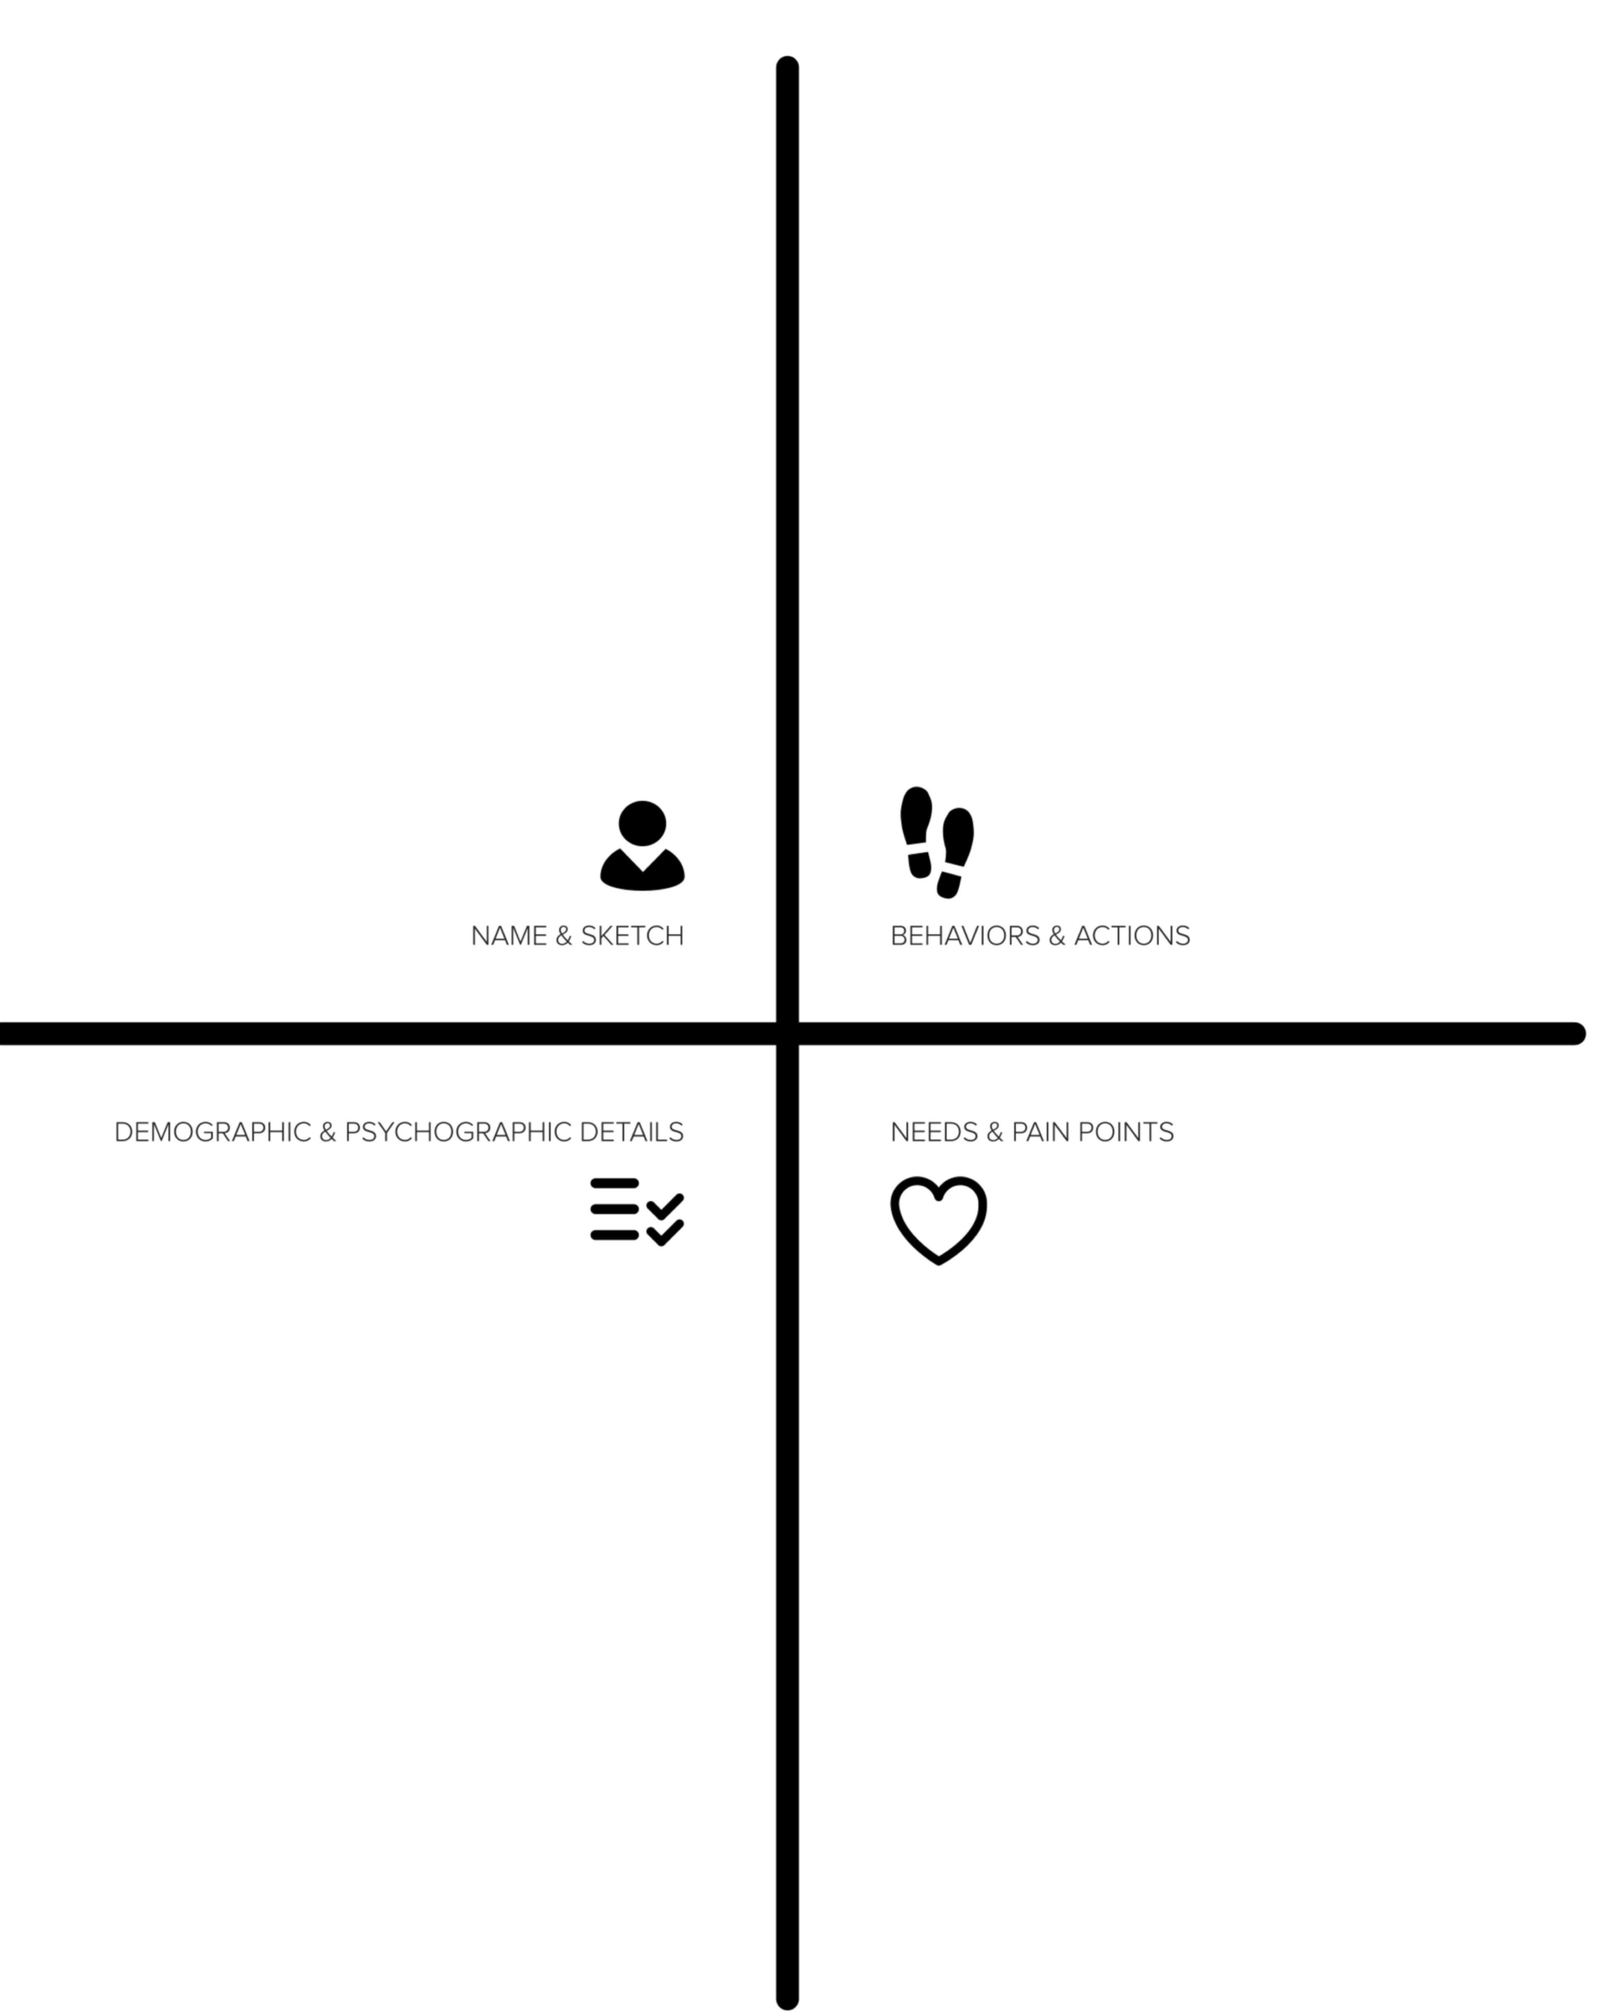

Slide 2
How might we
[solve]
[this thing]
for
[this person]?

Slide 4
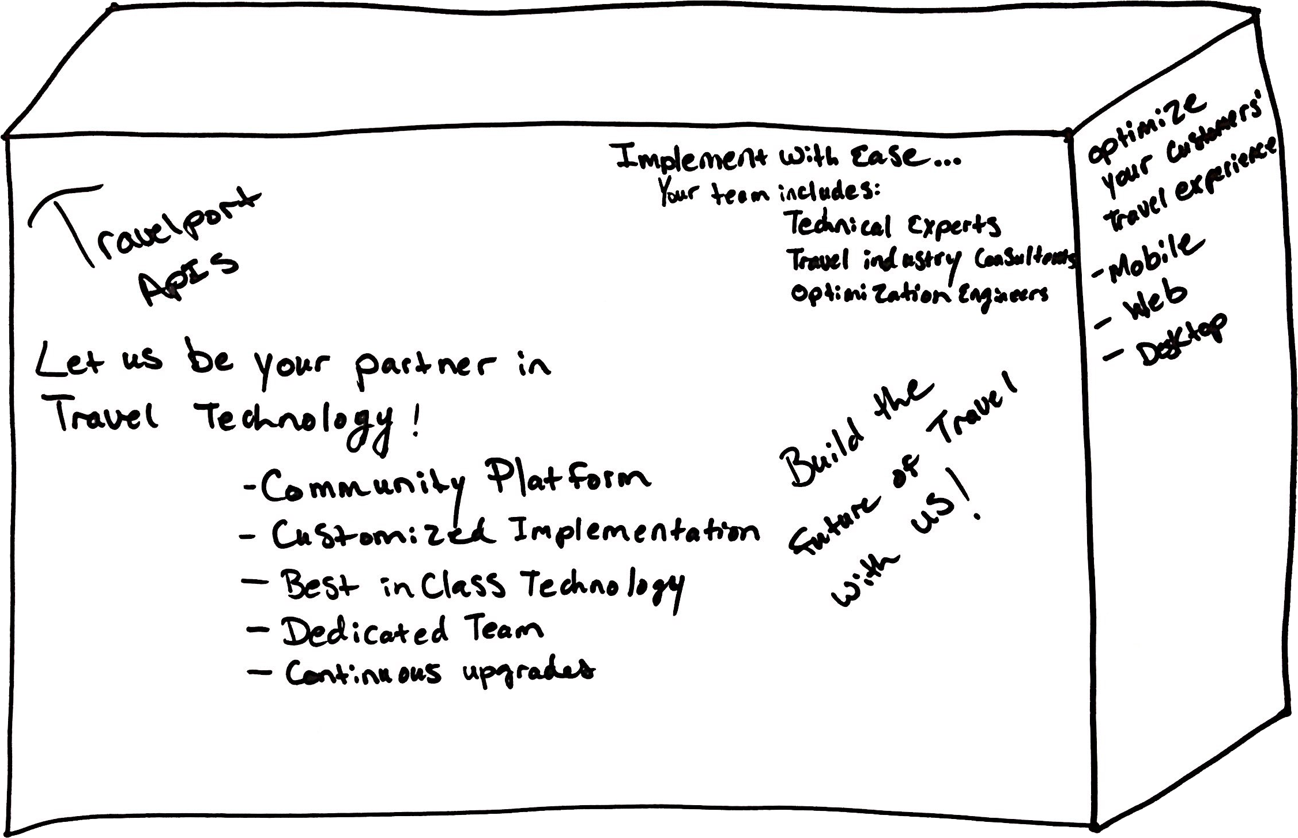
Notes:
Think of the exciting and colorful product boxes you see every day in super markets, shops, and portrayed virtually through online stores. The messages on these boxes help move these products off the shelves and into customers’ homes and lives.

Slide 5
Schedule a design coaching call with Econic here:
https://calendly.com/jonkohrs
Notes:
Think of the exciting and colorful product boxes you see every day in super markets, shops, and portrayed virtually through online stores. The messages on these boxes help move these products off the shelves and into customers’ homes and lives.

